Slide 1
Single Image Super Resolution (SISR)
Bharti Chaudhary

Slide 2
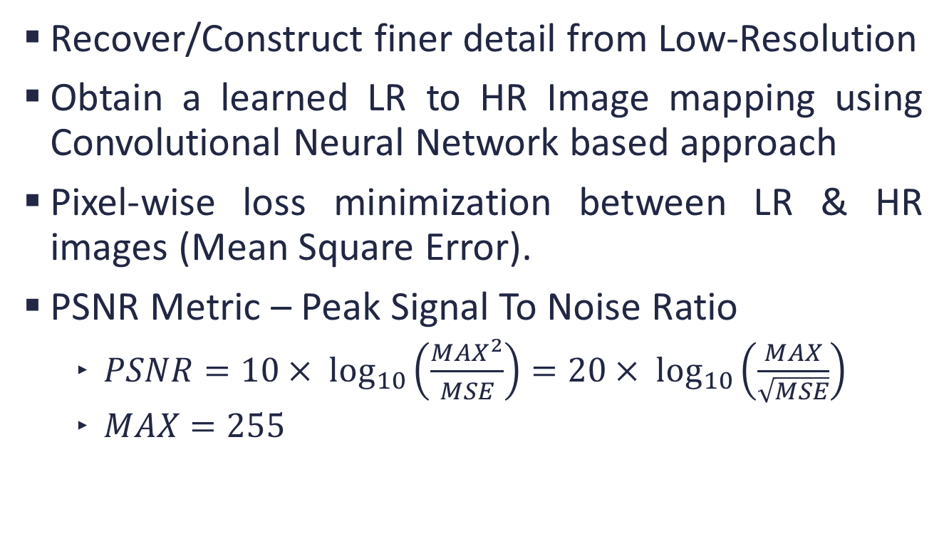
SISR
Recover/Construct finer detail from Low-Resolution
Obtain a learned LR to HR Image mapping using Convolutional Neural Network based approach
Pixel-wise loss minimization between LR & HR images (Mean Square Error).
PSNR Metric – Peak Signal To Noise Ratio
$PSNR=10× \log_{10}\left(\frac{{MAX}^{2}}{MSE}\right)=20× \log_{10}\left(\frac{MAX}{\sqrt{MSE}}\right)$
$MAX=255$
Notes:
Log to better caption MSE near zero

Slide 3
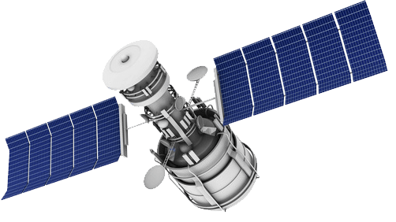
Applications of SISR
Satellite Imaging
Medical Imaging
Security Imaging
Note: No artificial texture generation can be tolerated in these applications

Slide 4
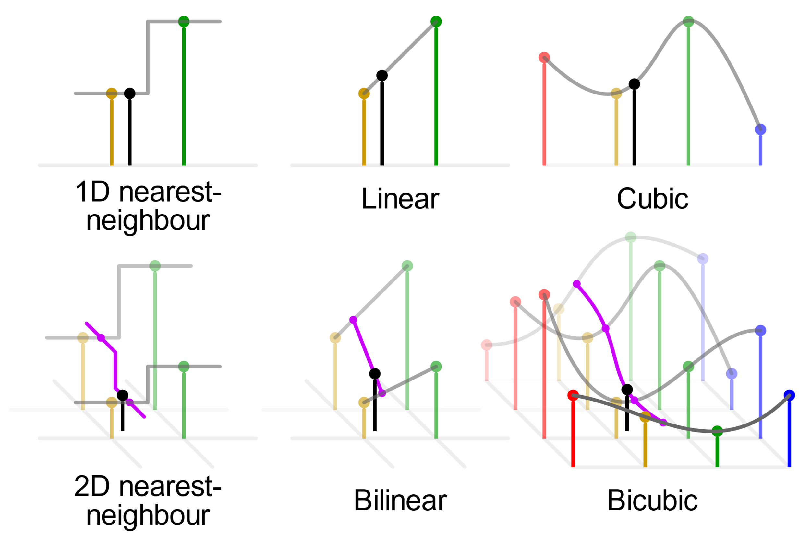
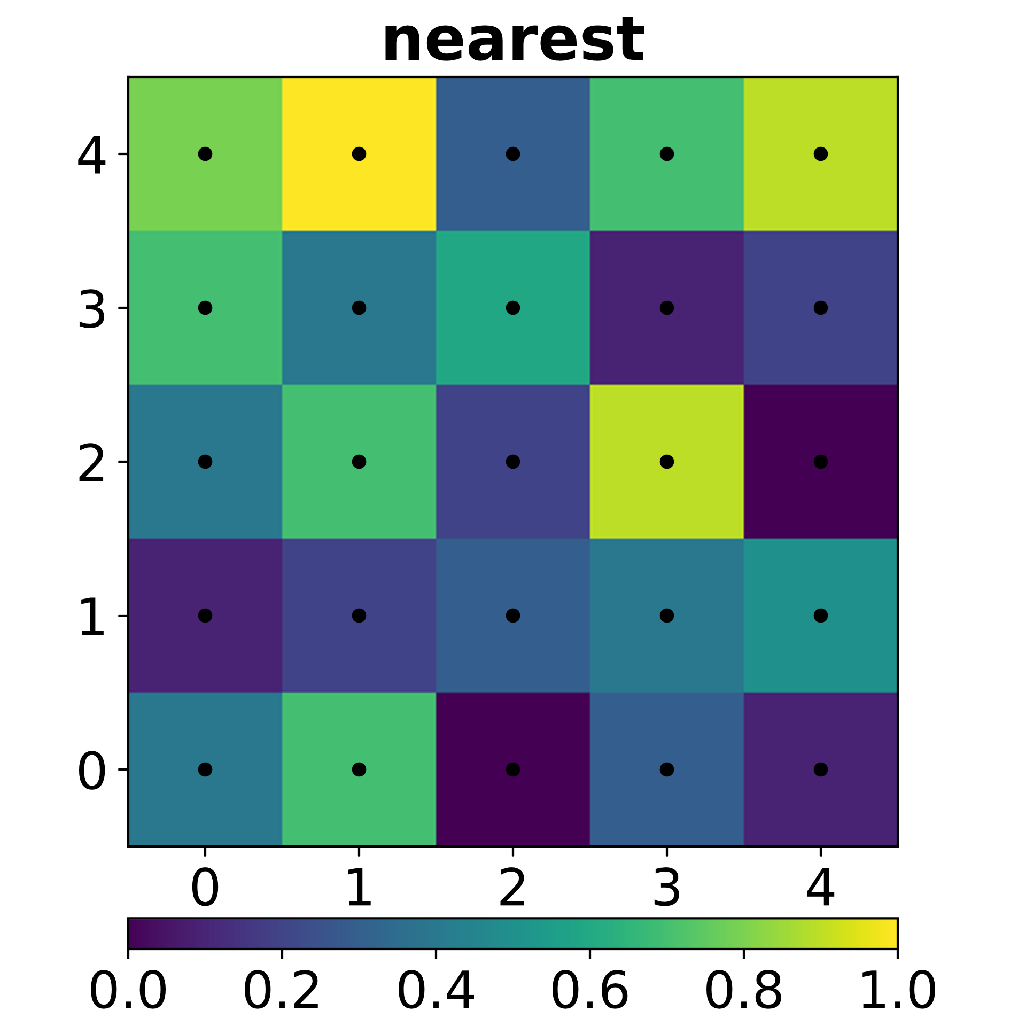
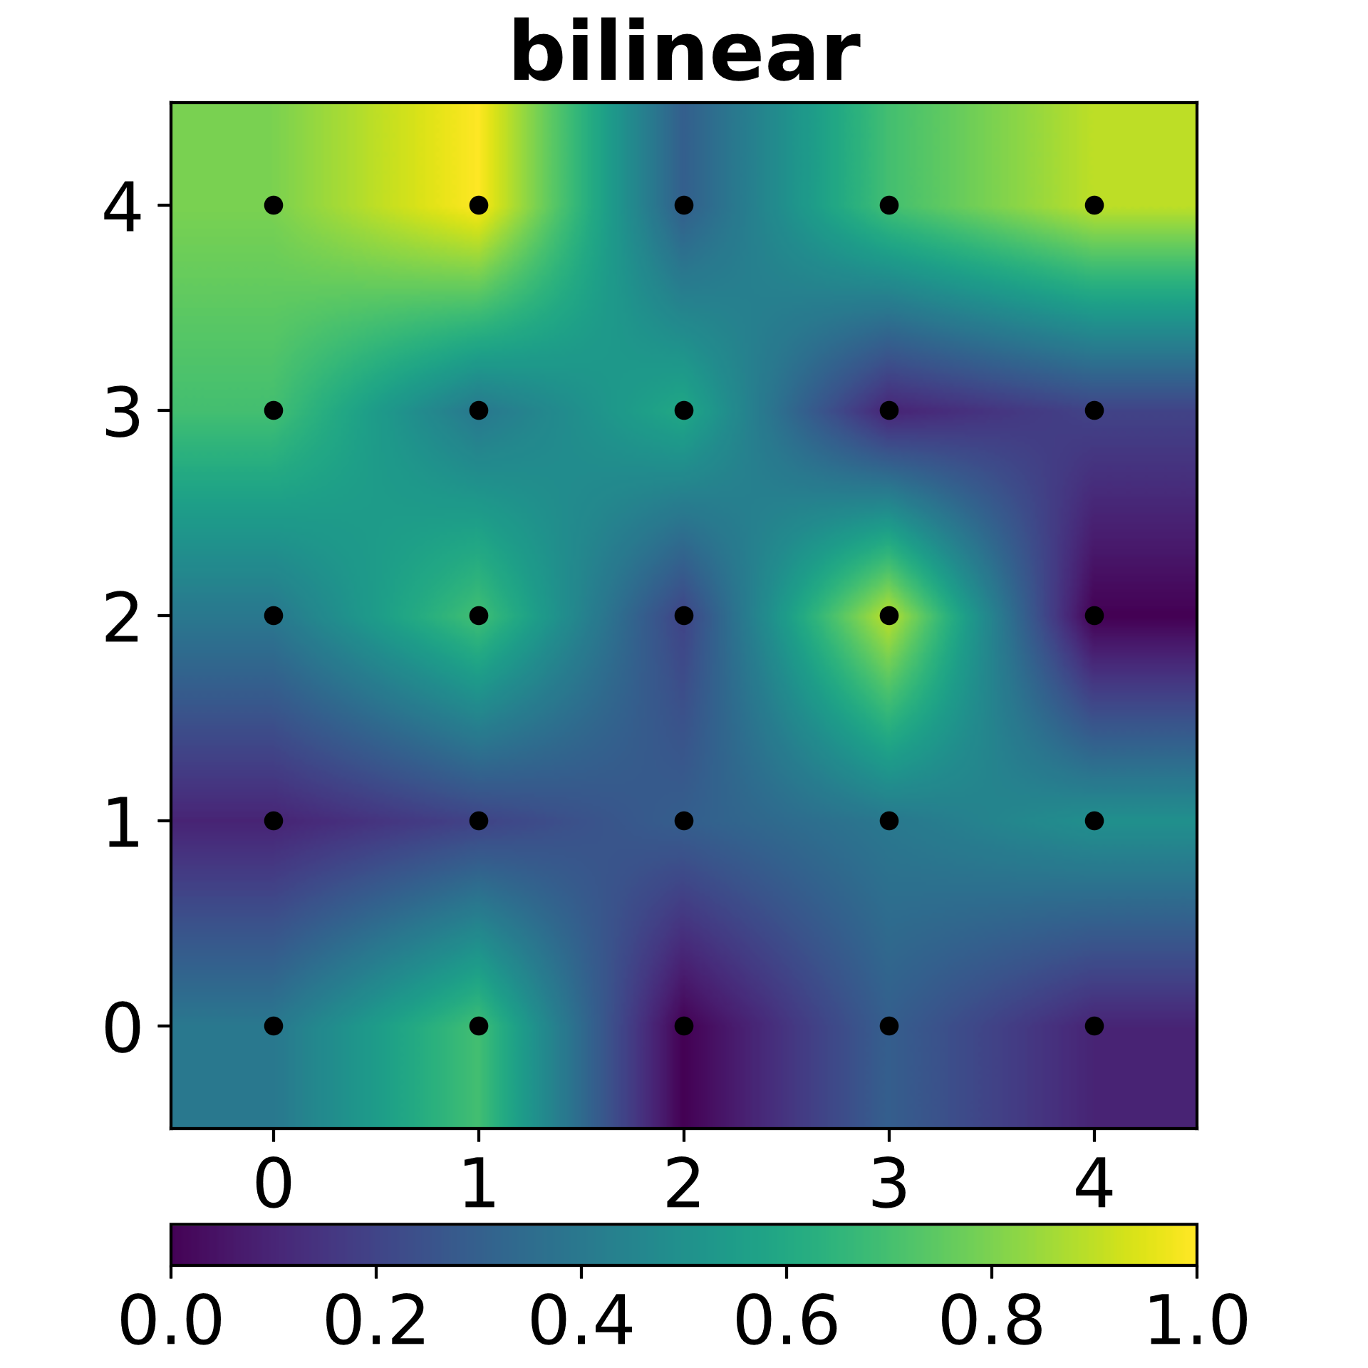
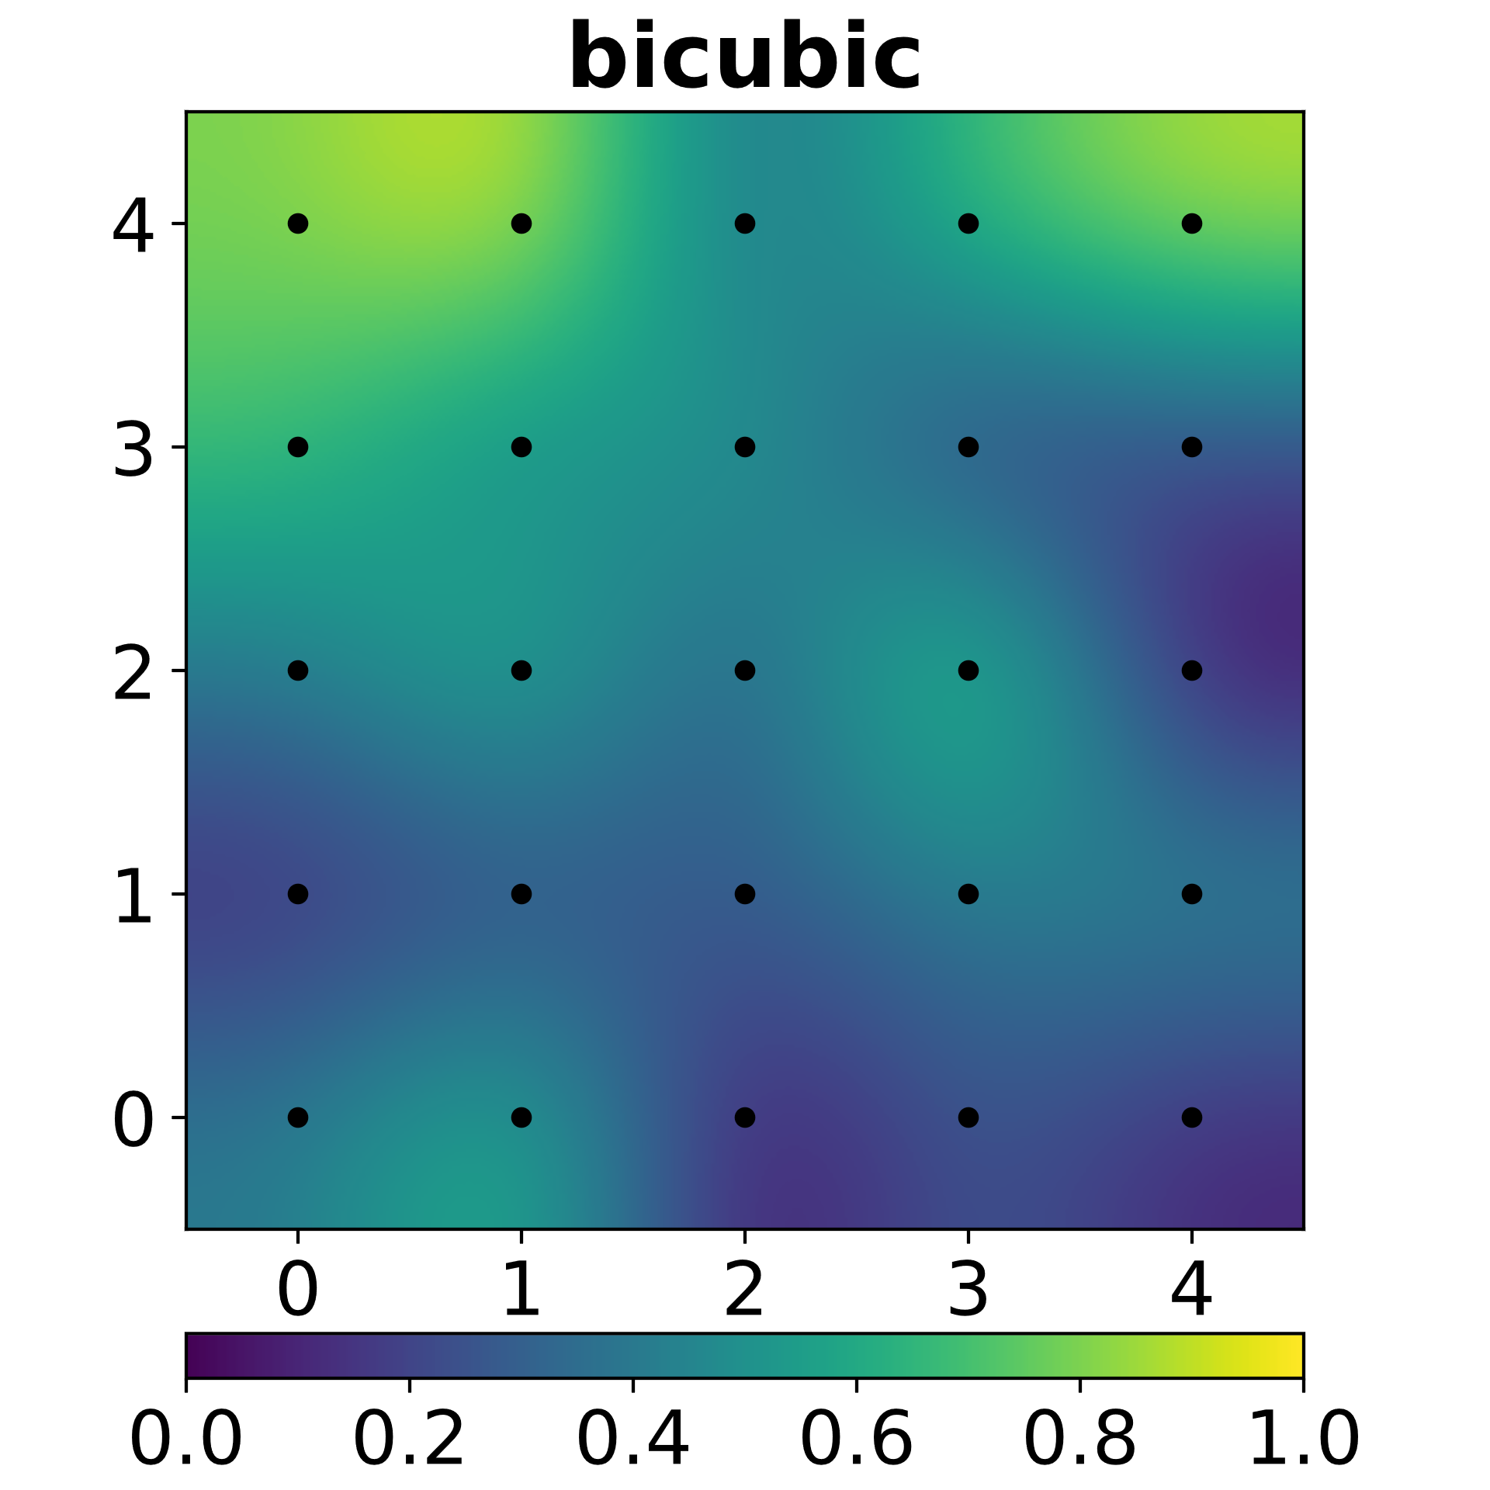
Classic Interpolation
Image courtesy : https://en.wikipedia.org/wiki/Bicubic_interpolation

Slide 5
Training Datasets
DIV2K: 800 images of 2K Resolution
Flickr2K: 2650 2K images
Challenge on Learned Image Compression (CLIC):
CLIC-professional: 585 images of 480p to 2K
CLIC-mobile: 1048 images of 320p to 2K

Slide 6
Testing Datasets
PIRM Perceptual Image Super-Resolution Challenge
BSDS100: 100 images
Set5 & Set14: common SISR evaluation datasets
Urban 100: FHD images of Urban scene
Manga 109: Images of Anime comic covers
Validation sets of DIV2K, CLIC

Slide 7
Data Preparation
Datasets are of High-Resolution images
Obtained Low Resolution via bicubic down-sampling
Scale Factor: 4
Patches
LR: 32x32
HR: 128x128
Patching Approach
HR Image is first Down-sampled and divided into patches for further processing
HR Image is first divided into patches of desired size and then Down-sampled for further processing
First approach is used in our experiments
Images of different resolution and formats
Notes:
Put patches wala animation

Slide 8
Experimental Setup
Intel(R) Core(TM) i7-8700K CPU @ 3.70GHz
16 GB DDR4 2400MHz RAM
12 GB NVIDIA 1080Ti GPU

Slide 9
Model Selection (Exp 0.)
Type 1: Takes interpolated LR image as input
High resource intensive & difficult to converge
Type 2: Takes LR input, works on LR feature space, later find a learned up-sampling
Less resource intense & converges easily
SRResNet is best in terms of accuracy & resource usage
Notes:
Vdsr, drrn,oadnn
Srresnet,edsr

Slide 10
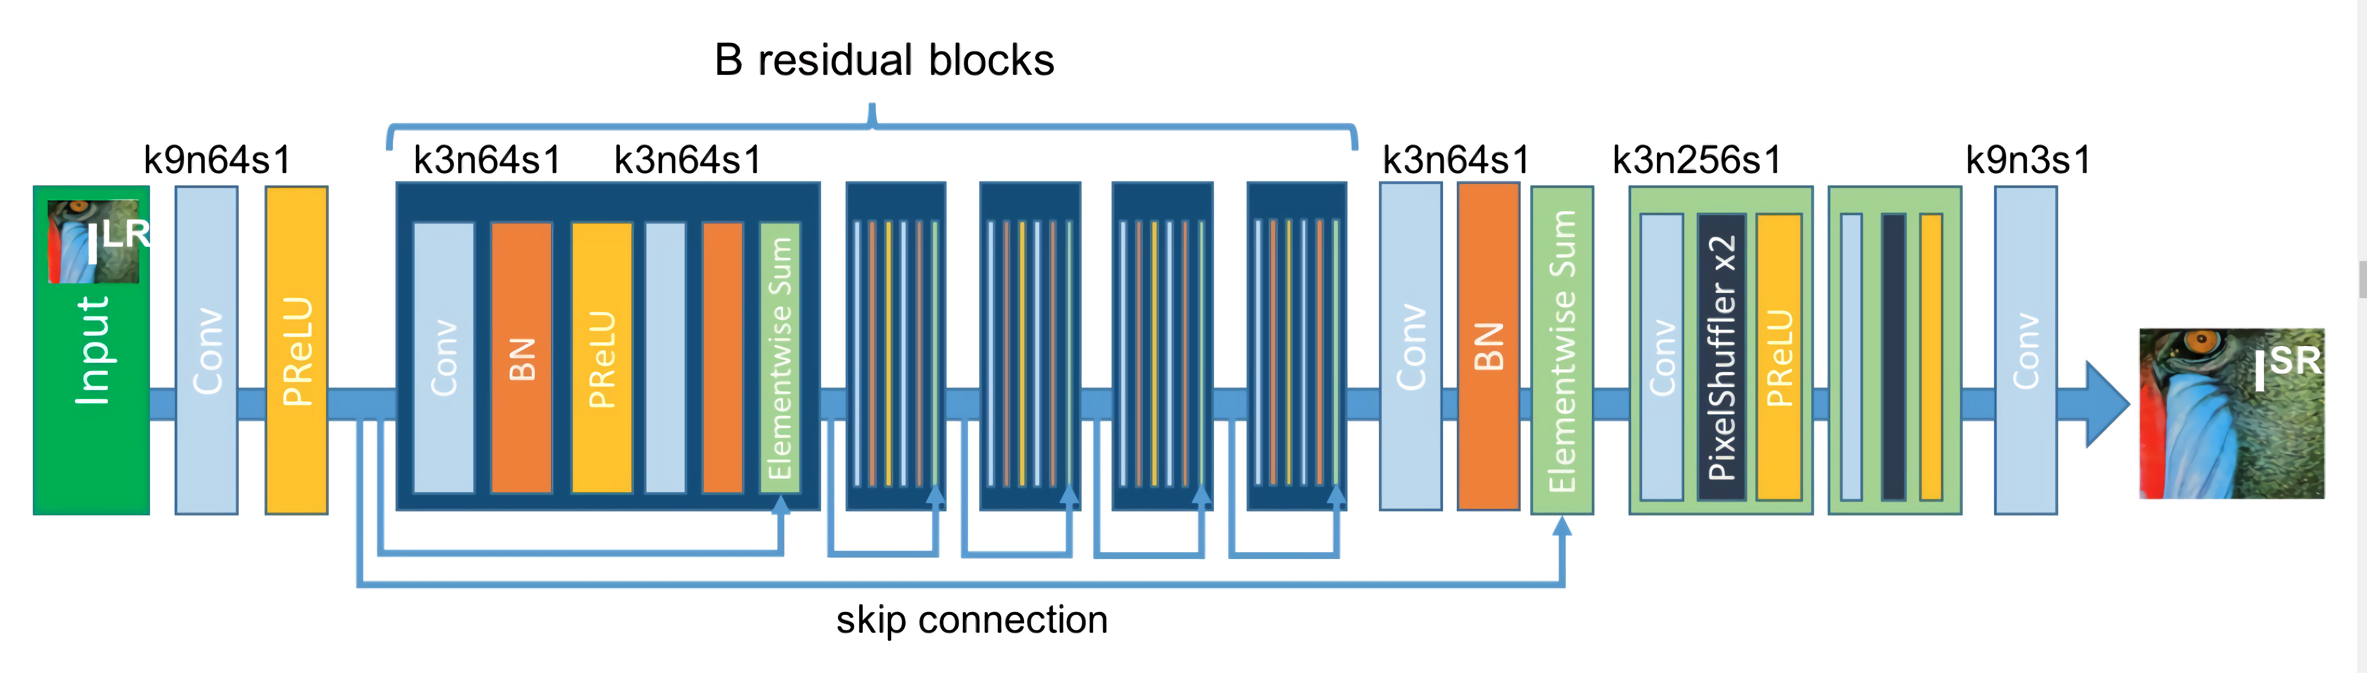
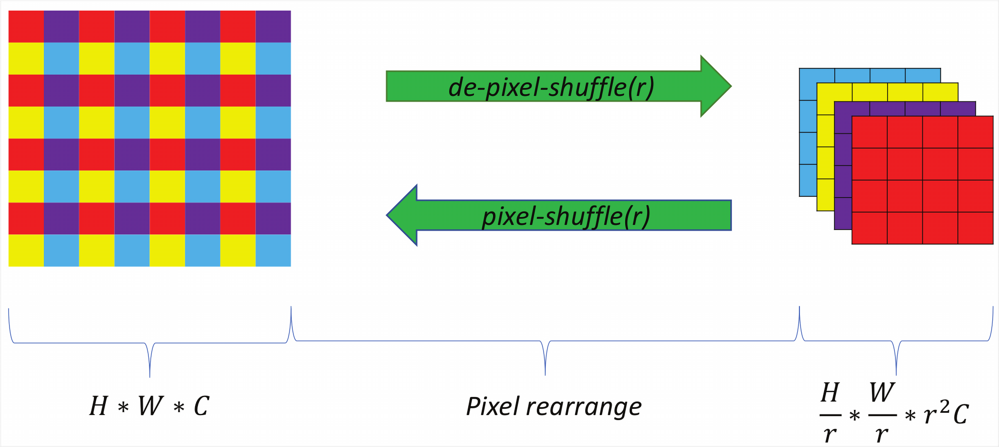
SRResNet Architecture
Notes:
B = 16

Slide 11

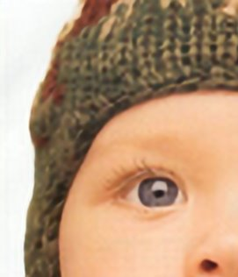
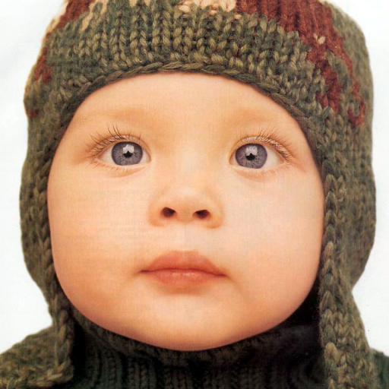
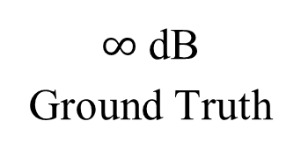
Output images & PSNR values
30.83 dB
LR (Bicubic)
32.50 dB
SRResNet
$∞$ dB
Ground Truth
PSNR Gain 1.67 dB

Slide 12
Mean PSNR Gain over Bicubic on separate SRResNet instances
Test/Valid Dataset | DIV2K | Flickr2K | CLIC-professional | CLIC-mobile | Min Diff
CLIC-mobile | 1.43 | 1.28 | 1.34 | 1.16 | 0.09
CLIC-professional | 1.64 | 0.88 | 1.49 | 1.20 | 0.15
DIV2K | 1.55 | 1.11 | 1.27 | 1.12 | 0.28
BSDS100 | 1.73 | 1.39 | 1.44 | 1.32 | 0.29
Manga109 | 4.01 | 3.75 | 3.39 | 3.03 | 0.26
PIRM | 1.40 | 1.27 | 1.25 | 1.08 | 0.13
PIRM | 1.37 | 1.24 | 1.19 | 1.02 | 0.13
Set5 | 1.79 | 1.65 | 1.57 | 1.38 | 0.14
Set14 | 2.77 | 2.33 | 2.45 | 1.98 | 0.32
Urban100 | 2.00 | 1.86 | 1.78 | 1.57 | 0.14
Notes:
Min Diff, is Minimum PSNR gain, by training on best & second best dataset

Slide 13
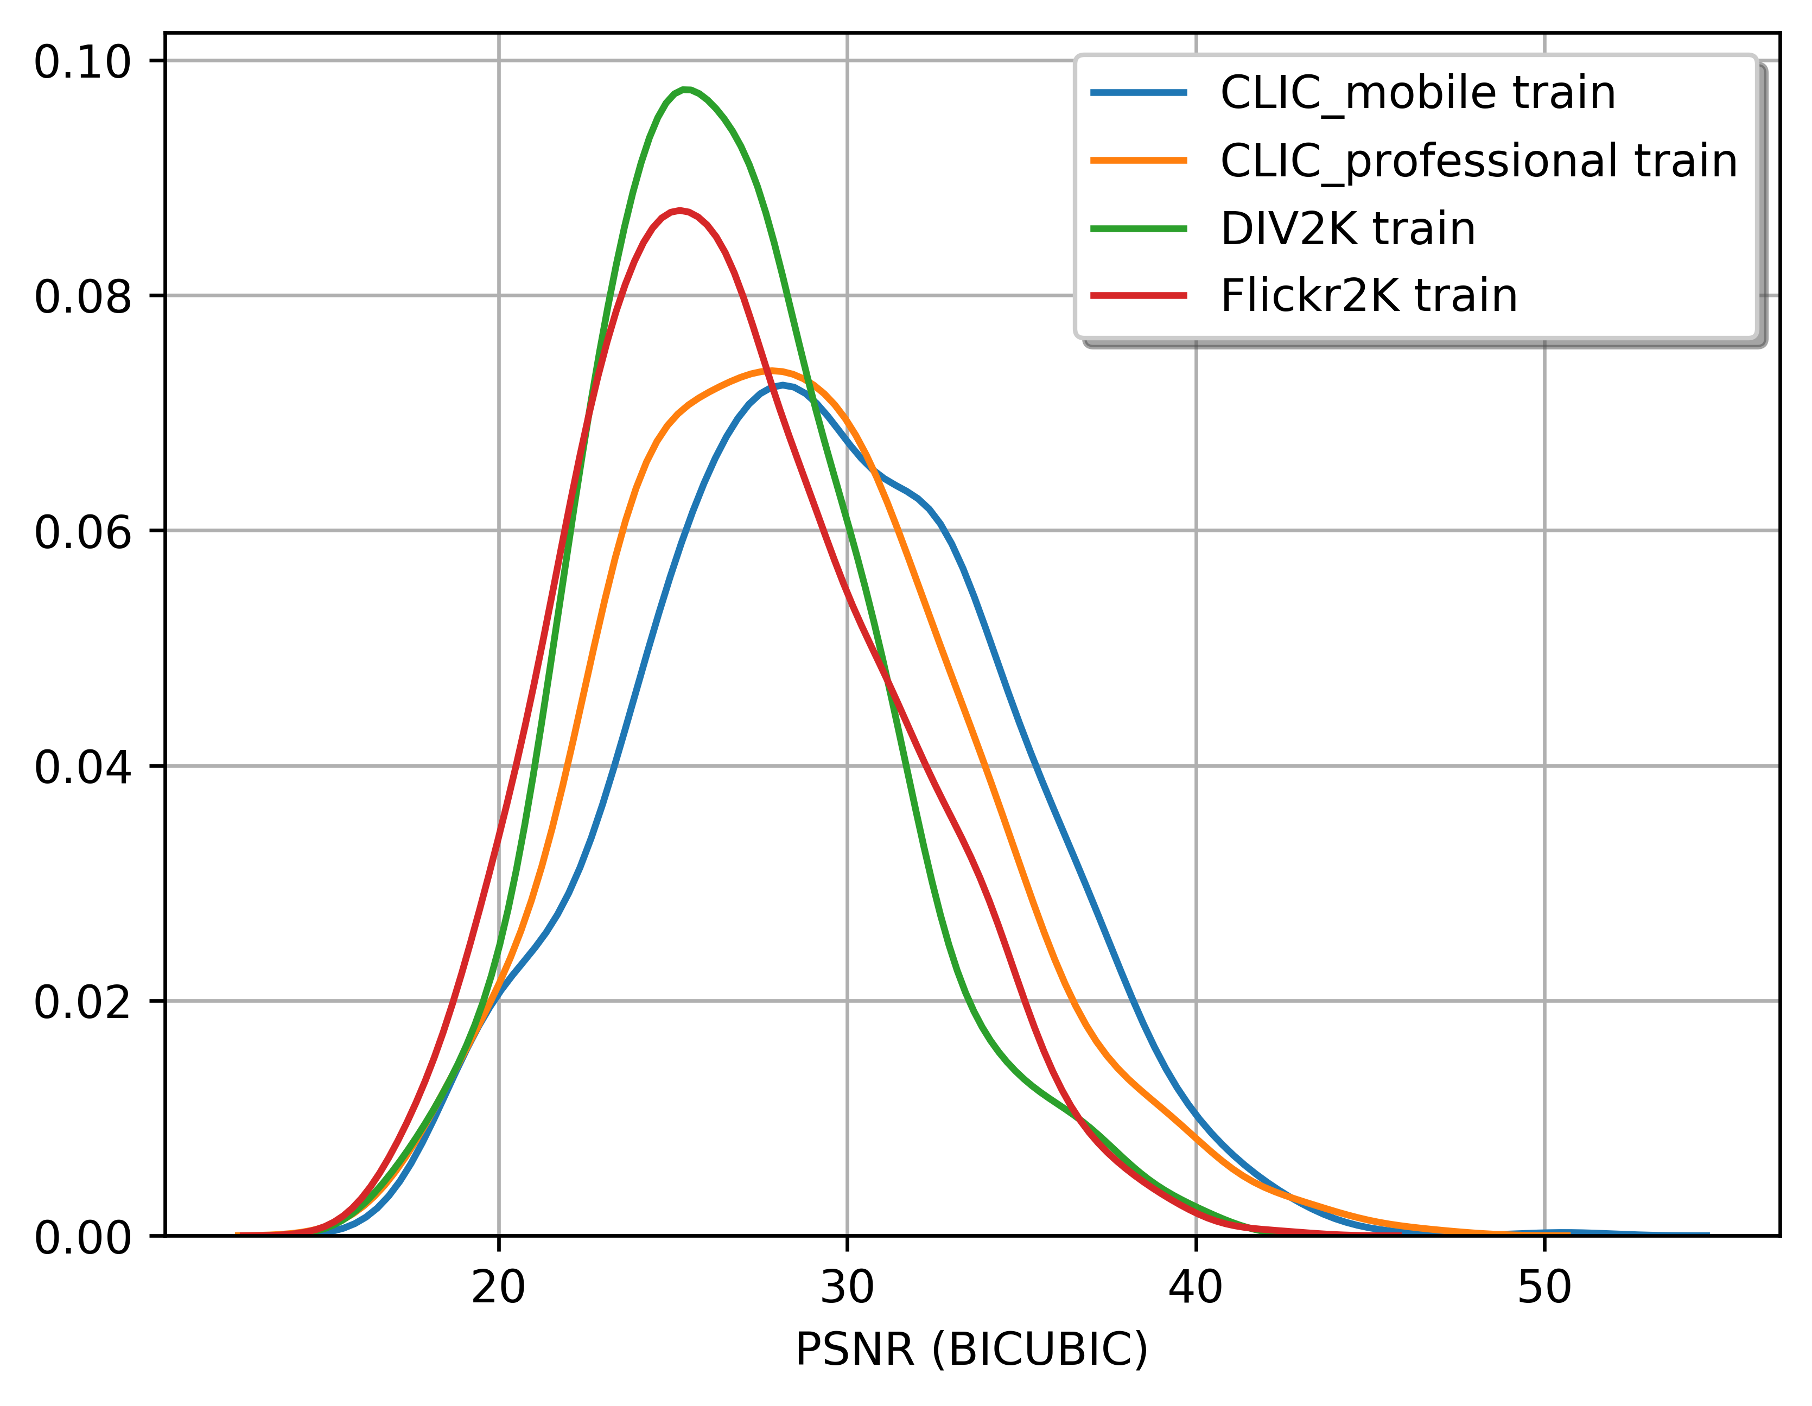
Data-Set Ranking (Exp 1.)
Why (& How) training on different dataset matter?
Fine details are difficult to recover from Bicubic
Notes:
Gaussian density estimation, of PSNR from bicubic of all training sets

Slide 14
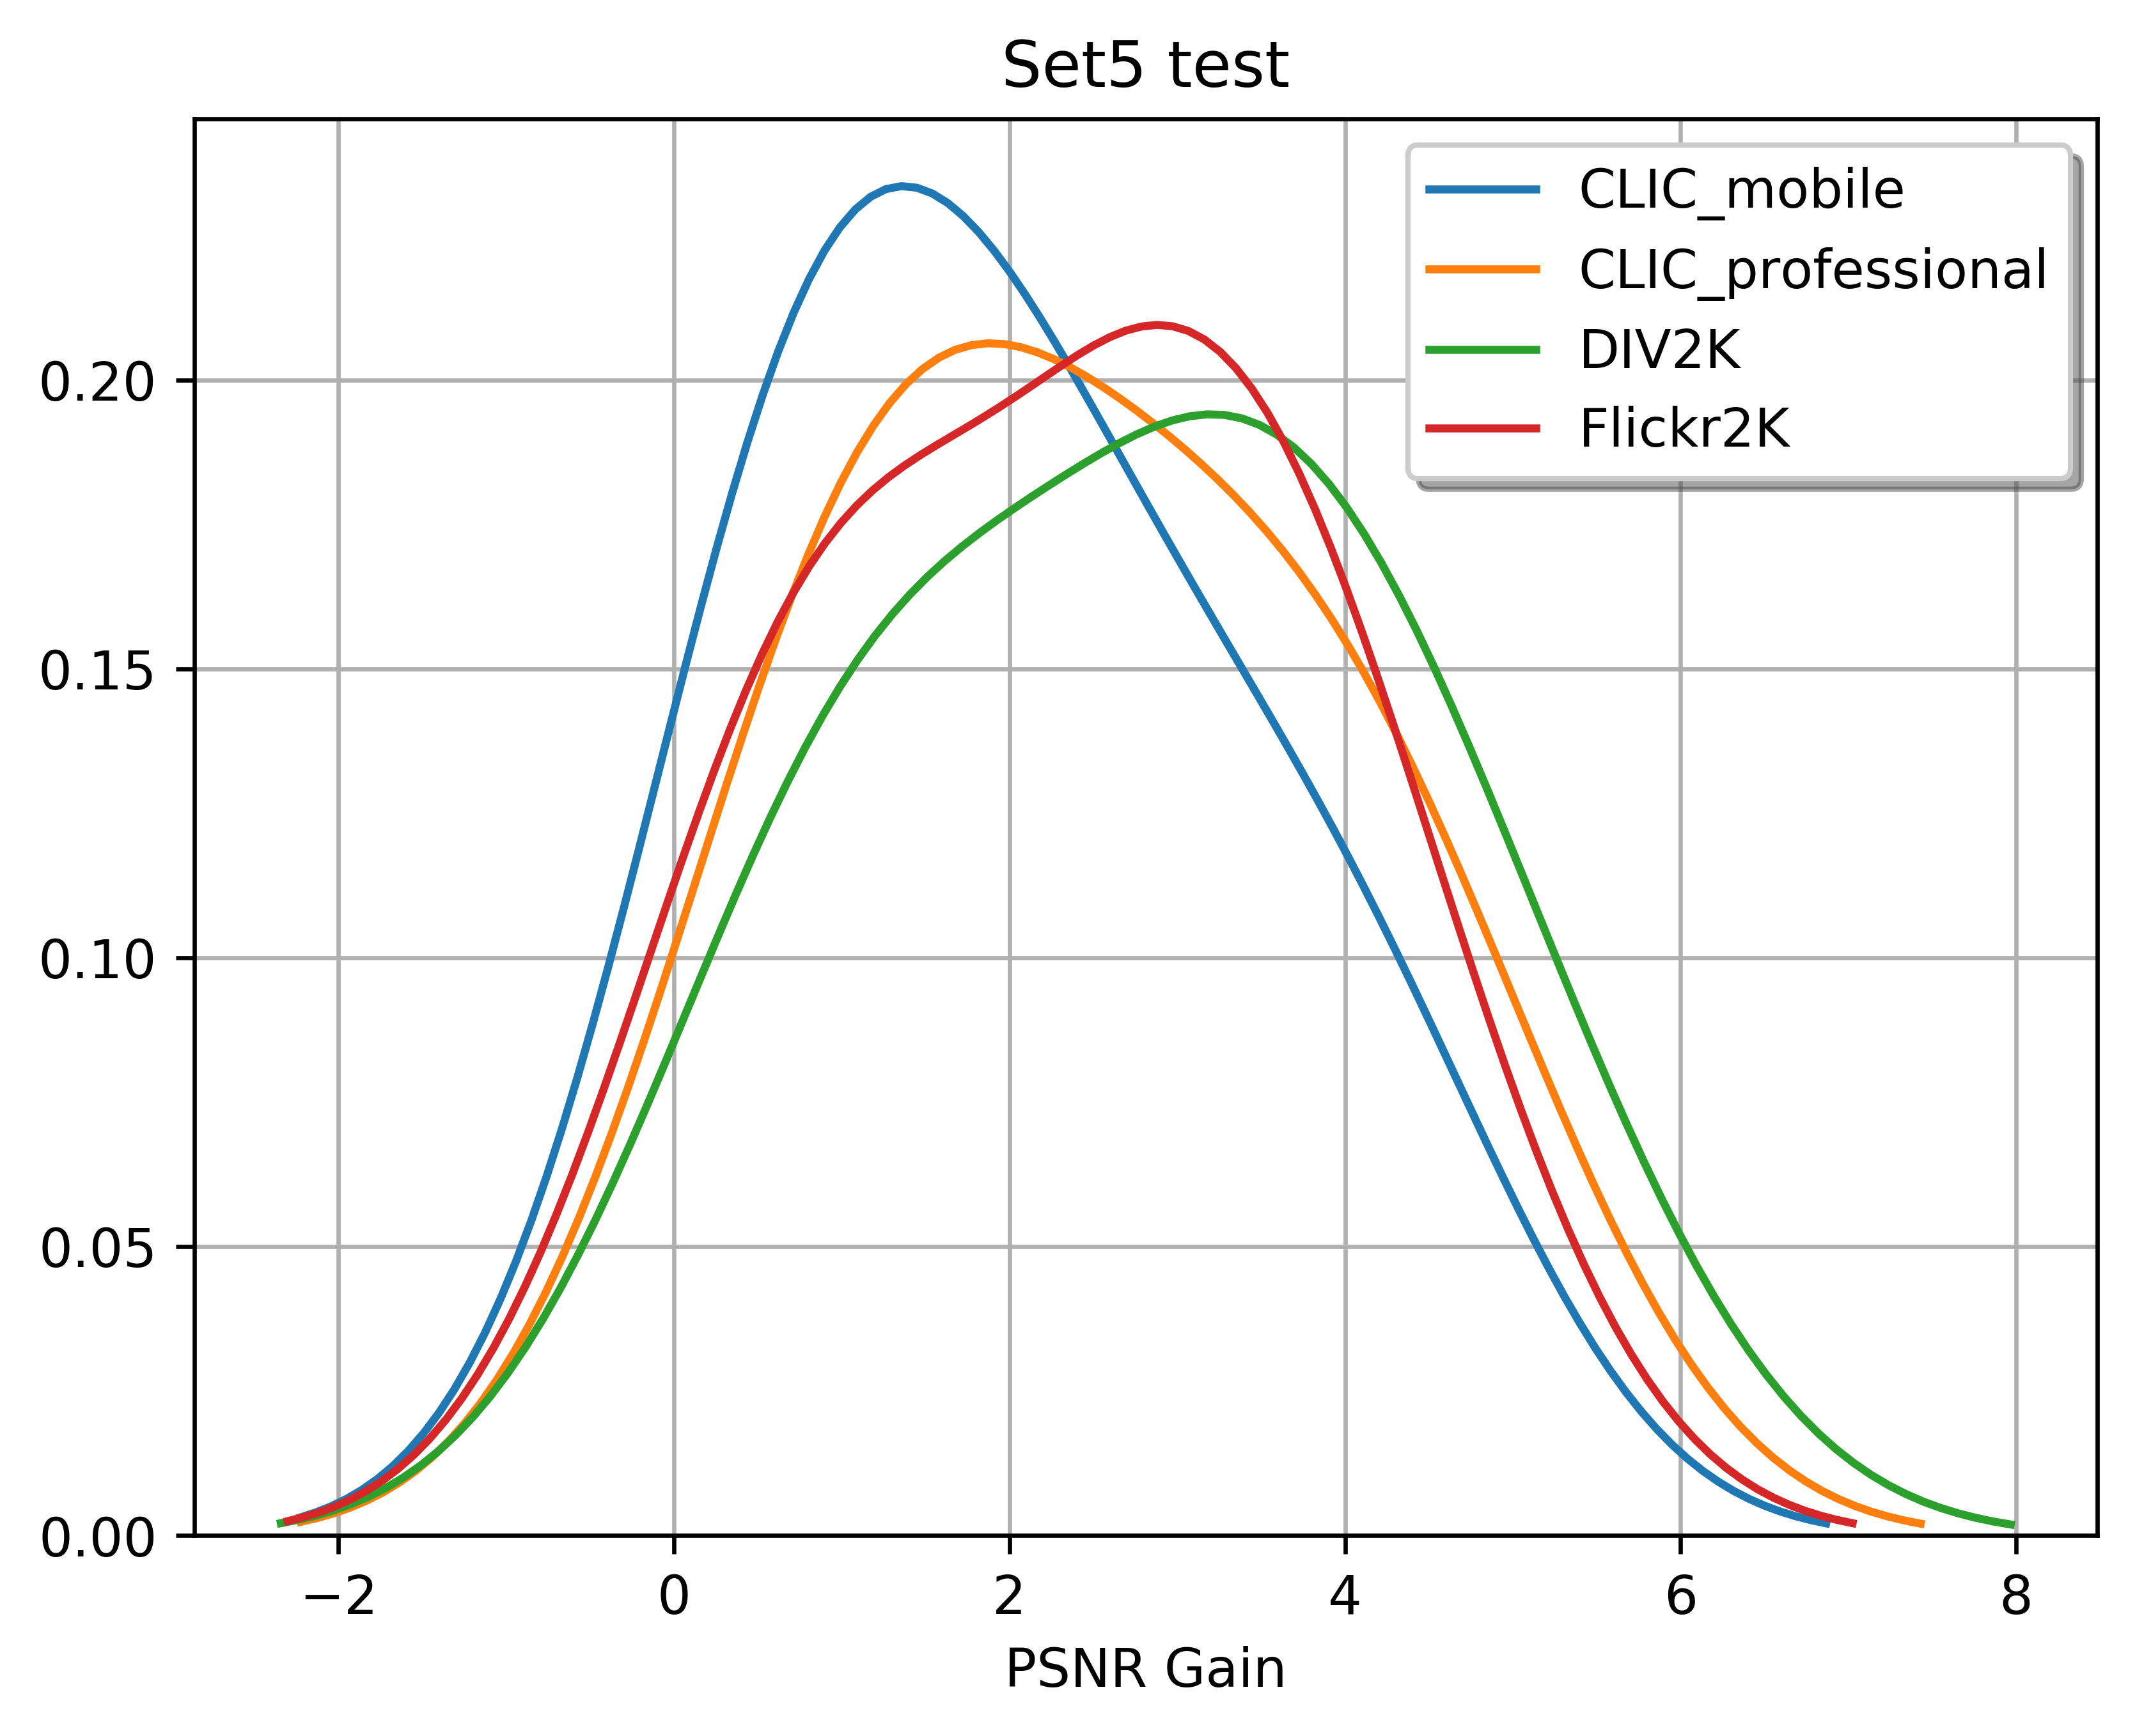
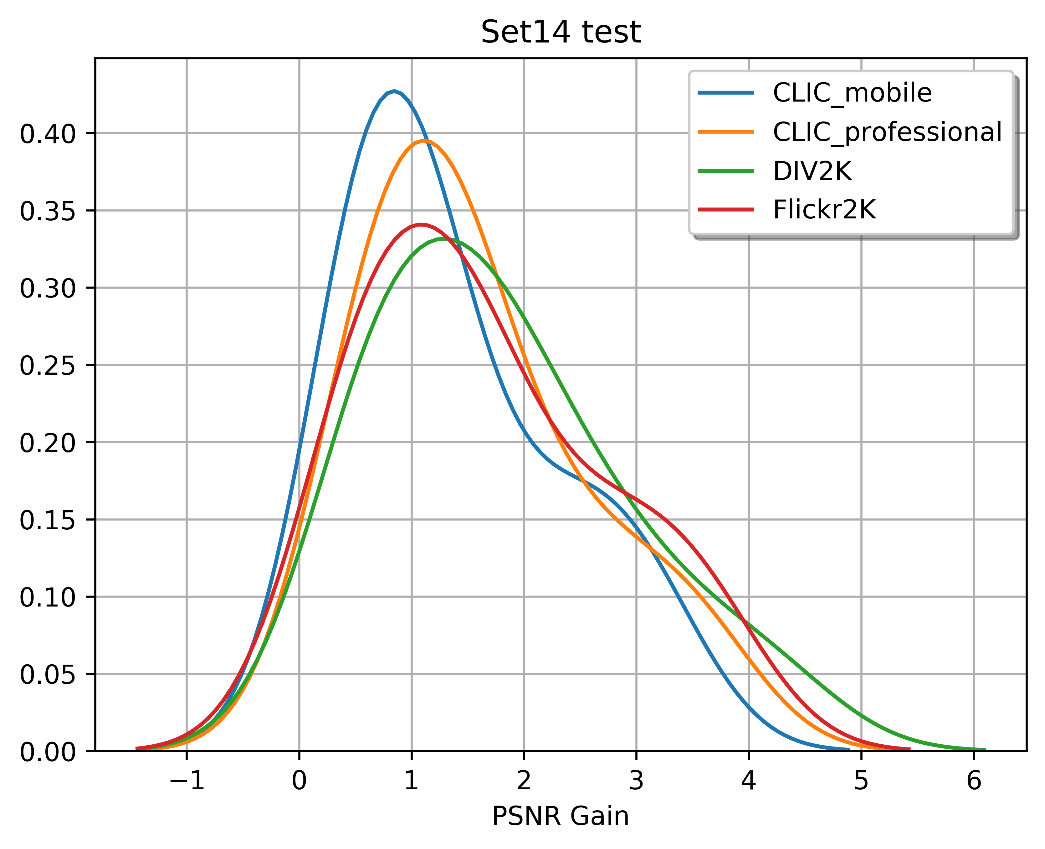
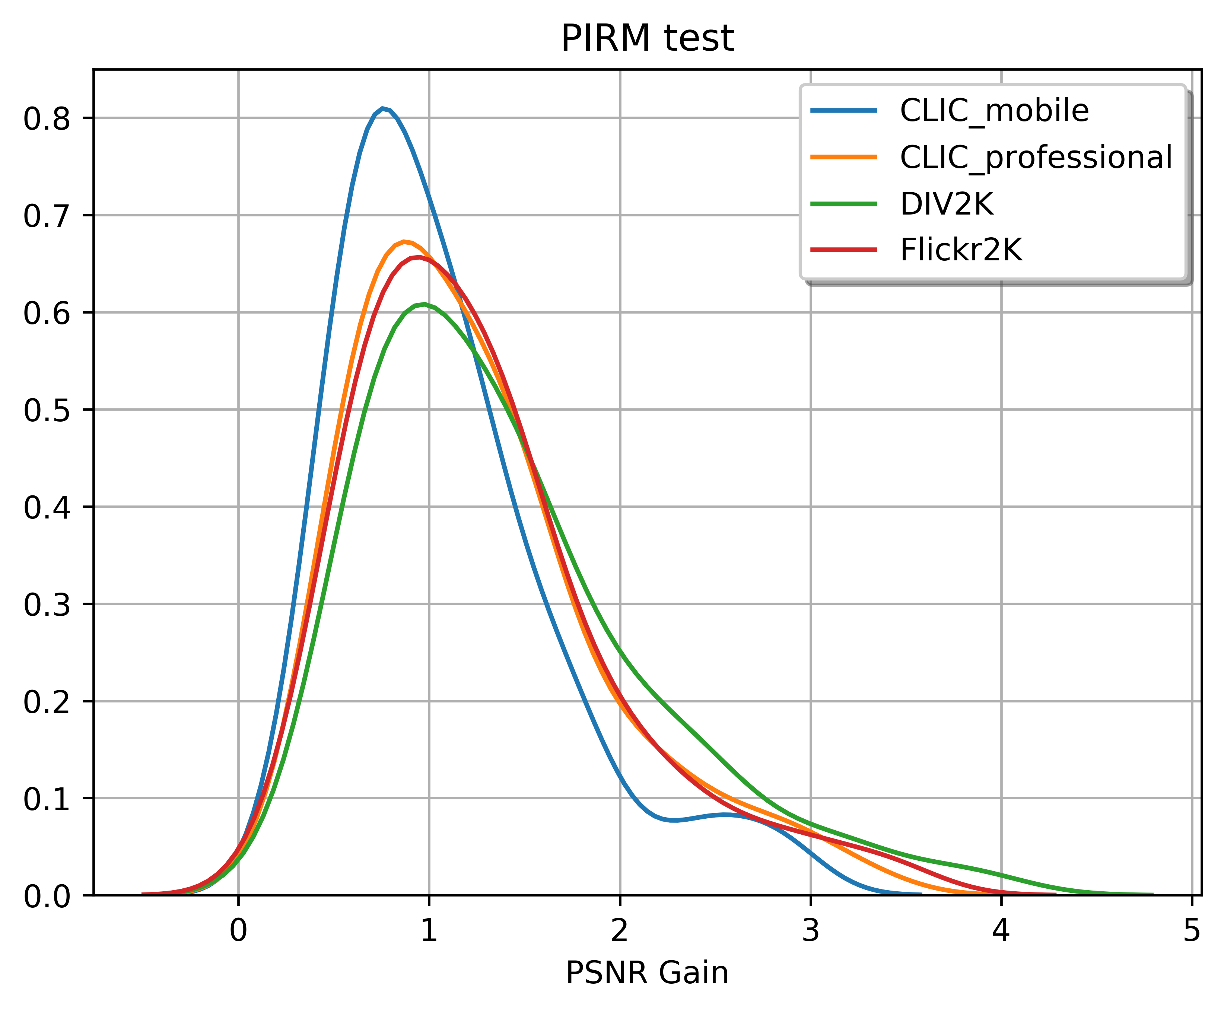
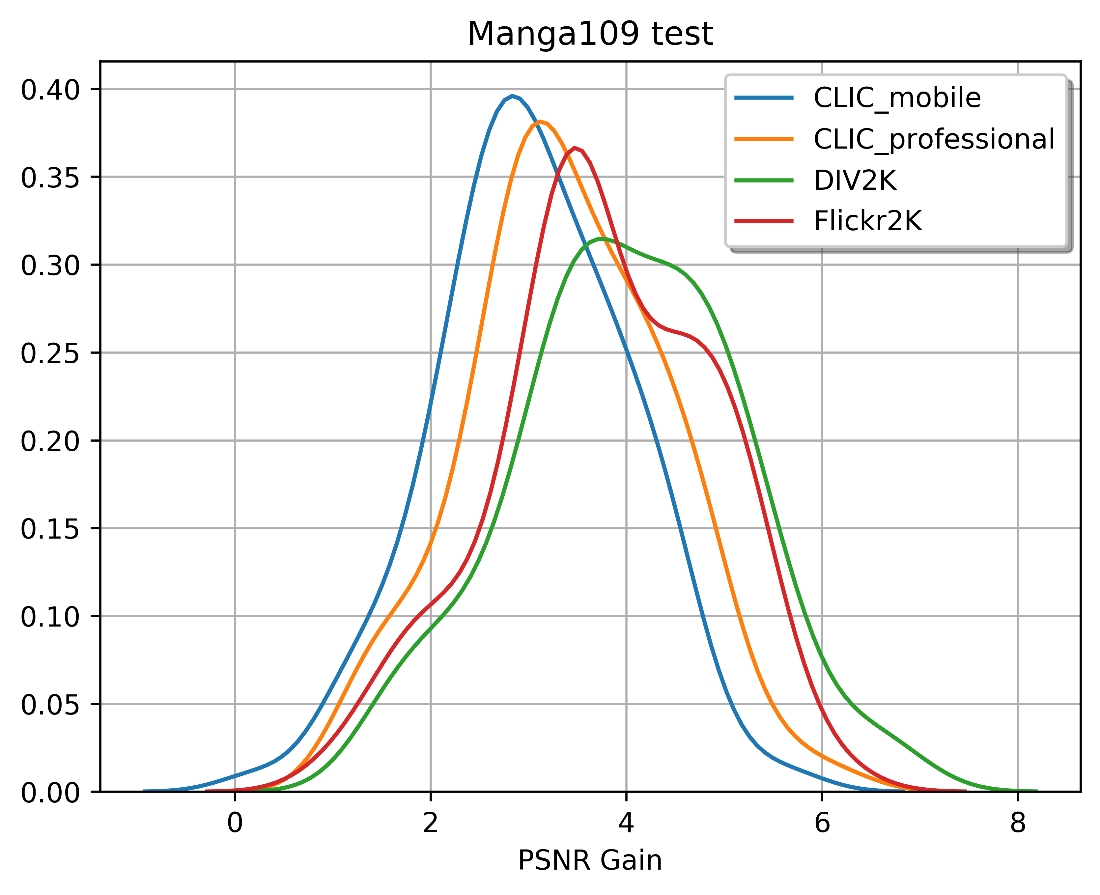
Data-Set Ranking (Exp 1.)
Notes:
Order on X-axis from previous slides are reversed as per our observation

Slide 15
Core Findings & Conclusion
Dataset-Ranking approach helps obtaining better performance
Combining all datasets will saturate in practice
Analysed various SISR models from the literature
Characterize training datasets for best performance

Slide 16
Future Work
Similar Dataset Ranking approaches can be used for other low-level vision applications like Compression Artefacts Removal, De-noising.,

Slide 17
References
Yang, Wenming, et al. "Deep learning for single image super-resolution: A brief review." IEEE Transactions on Multimedia (2019).
Du, Chen, et al. "Orientation-Aware Deep Neural Network for Real Image Super-Resolution." Proceedings of the IEEE Conference on Computer Vision and Pattern Recognition (CVPR) Workshops. 2019.
Blau, Yochai, et al. "The 2018 PIRM challenge on perceptual image super-resolution." Proceedings of the European Conference on Computer Vision (ECCV). 2018.
Ledig, Christian, et al. "Photo-realistic single image super-resolution using a generative adversarial network." Proceedings of the IEEE conference on computer vision and pattern recognition. 2017.
Agustsson, E., & Timofte, R. (2017). NTIRE 2017 challenge on single image super-resolution: Dataset and study. In Proceedings of the IEEE Conference on Computer Vision and Pattern Recognition (CVPR) Workshops (pp. 126-135).
CLIC Challenge - https://www.compression.cc/challenge/

Slide 18
Thank You!
Questions?

